Slide 1
Stem Cells and The Intestine Workshop

Slide 2
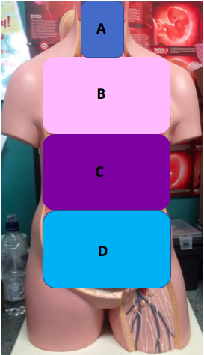
Where in the body is our intestine?

Slide 3
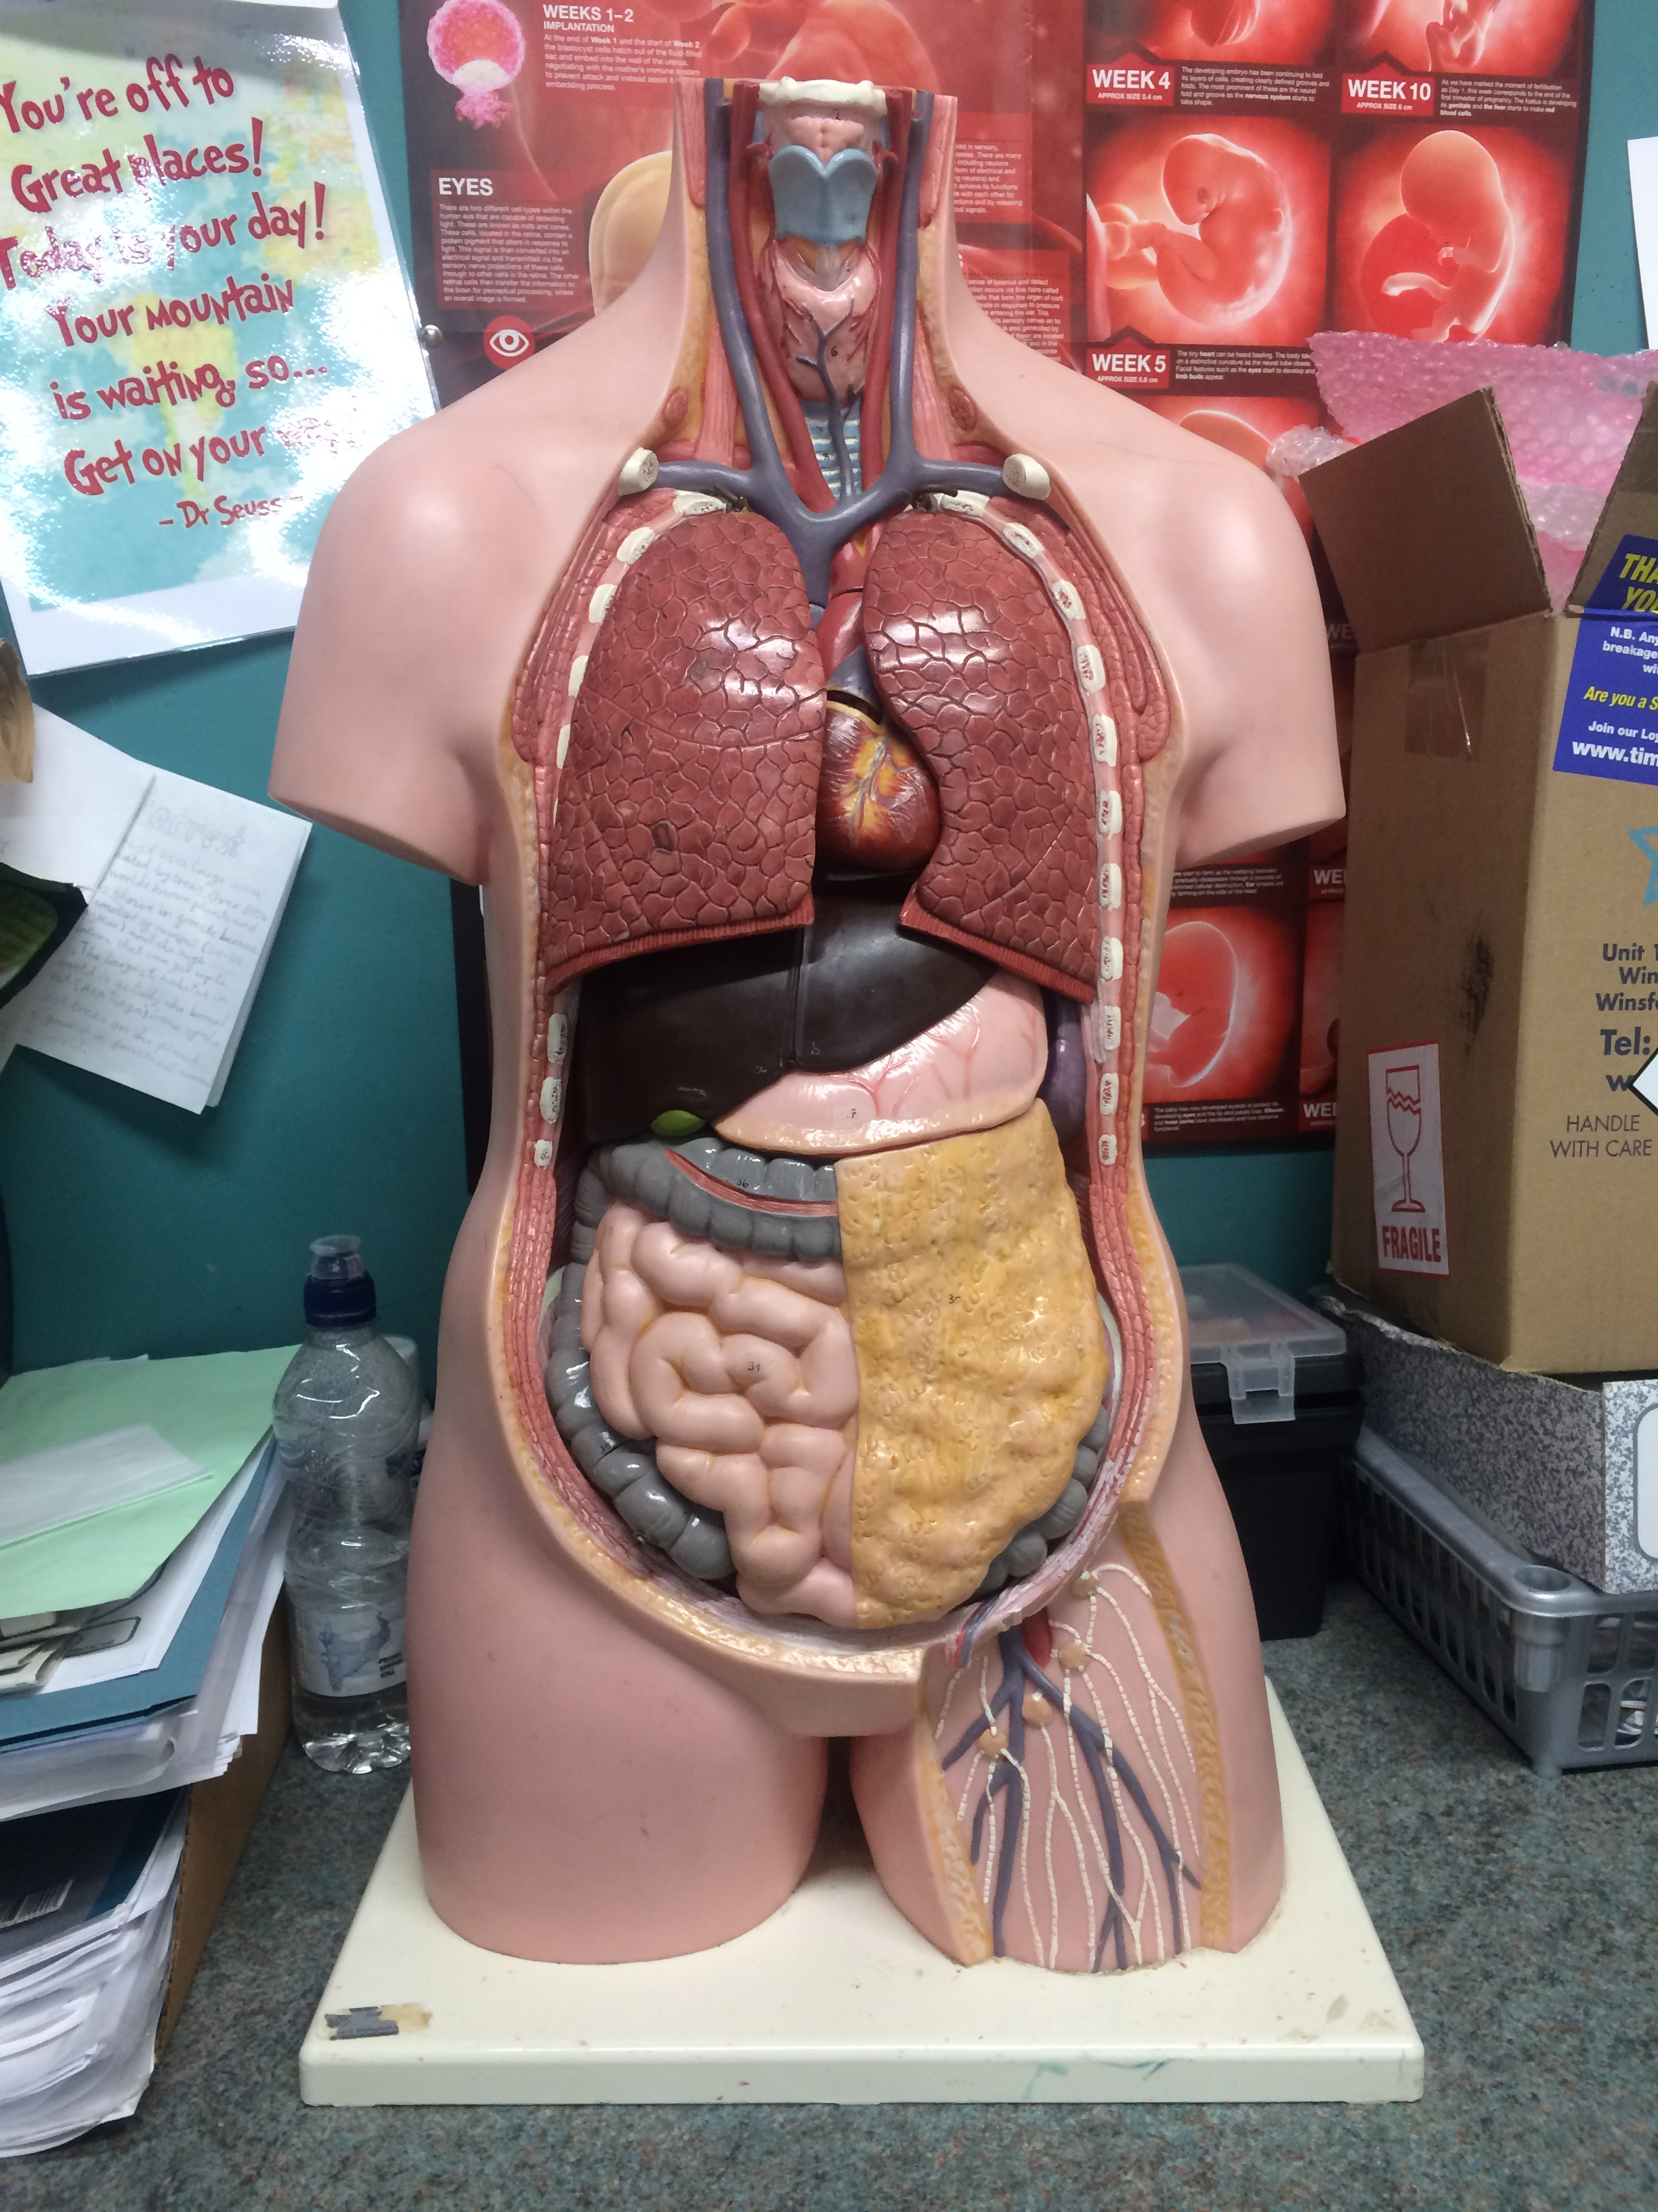
Where in our bodies are the intestine?
Our intestines are in our lower belly and there is both a LARGE and a small intestine.

Slide 4
How long is the intestine?
A 2.5m
B 5.5m
C 8.5m
D 11.5m

Slide 5
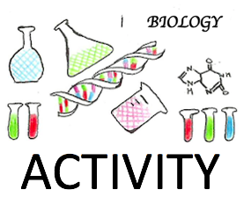
How long is the Intestine?

Slide 6
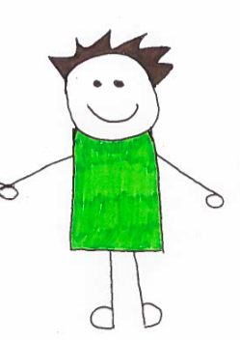
How long is the Intestine?
Its 8.5 meters long
That’s the same length as a double decker bus.
Or
As tall as a giraffe with a person standing on their
head!!
8.5m
8.5m

Slide 7
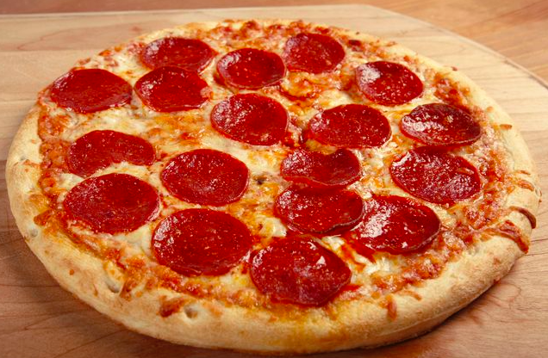
What does our intestine do?
FOOD
DIGESTION
Are food gets cut up into smaller and small pieces
ABSORBTION
Our food gets take from our intestine into our blood
ENERGY

Slide 8
ABSORBTION
Which of these two structures do you think will take up food more quickly?
A
B
Notes:
Do a demonstration with a piece of string -

Slide 9
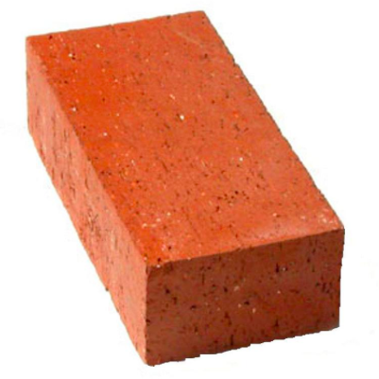
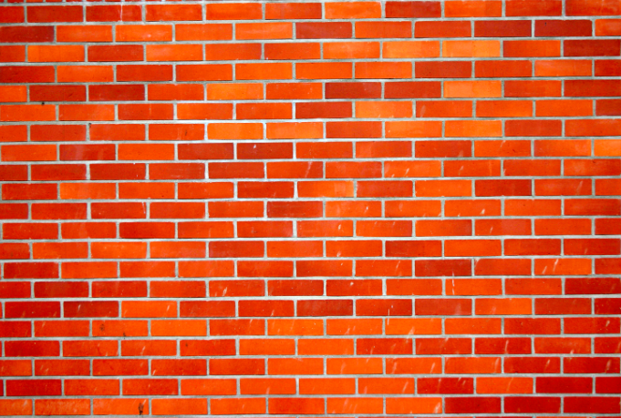
So what are the building blocks of our intestine?
A brick
A Cell
The intestine wall
Wall

Slide 10
All our cells start off as:
A Blood cells
B Stem cells
C Brain cells
D Intestine cells

Slide 11
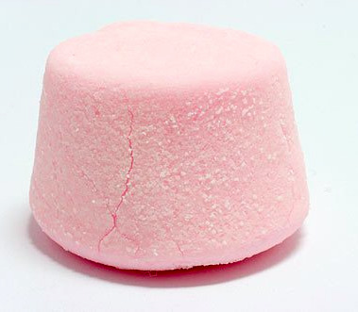
How do we produce the cells?
START: with a stem cell.

Slide 12
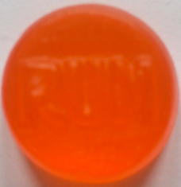
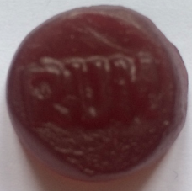
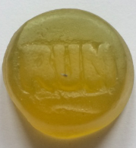
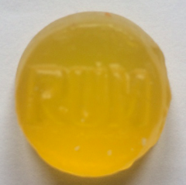
How do we produce the cells?
START: with a STEM CELL
Pick out a piece of paper to change you stem cell into a specialised cell
OR CAN PRODUCE ANOTHER STEM CELL
ENTEROCYTES CELLS
GOBLET CELLS
ENTEROENDOCRINE CELLS
PANETH CELLS

Slide 13
Villus
Stem cell
Stem cell are at the bottom of the villi – the base of the wall!

Slide 14
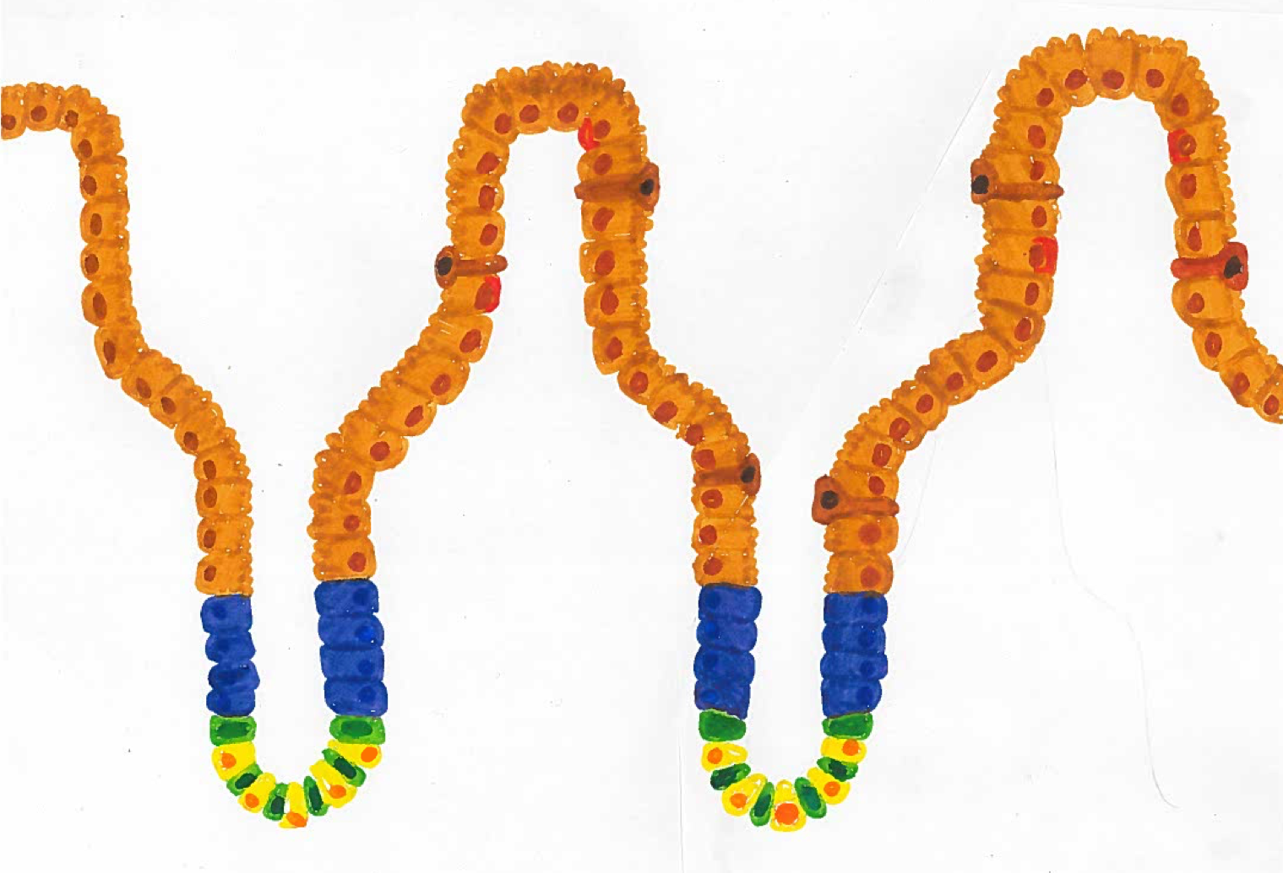
What happens when part of intestine is damaged?
Part of the intestine gets damaged
If the damaged part of the intestine gets removed it results in a shorter intestine.
THINK: What consequences might this have?

Slide 15
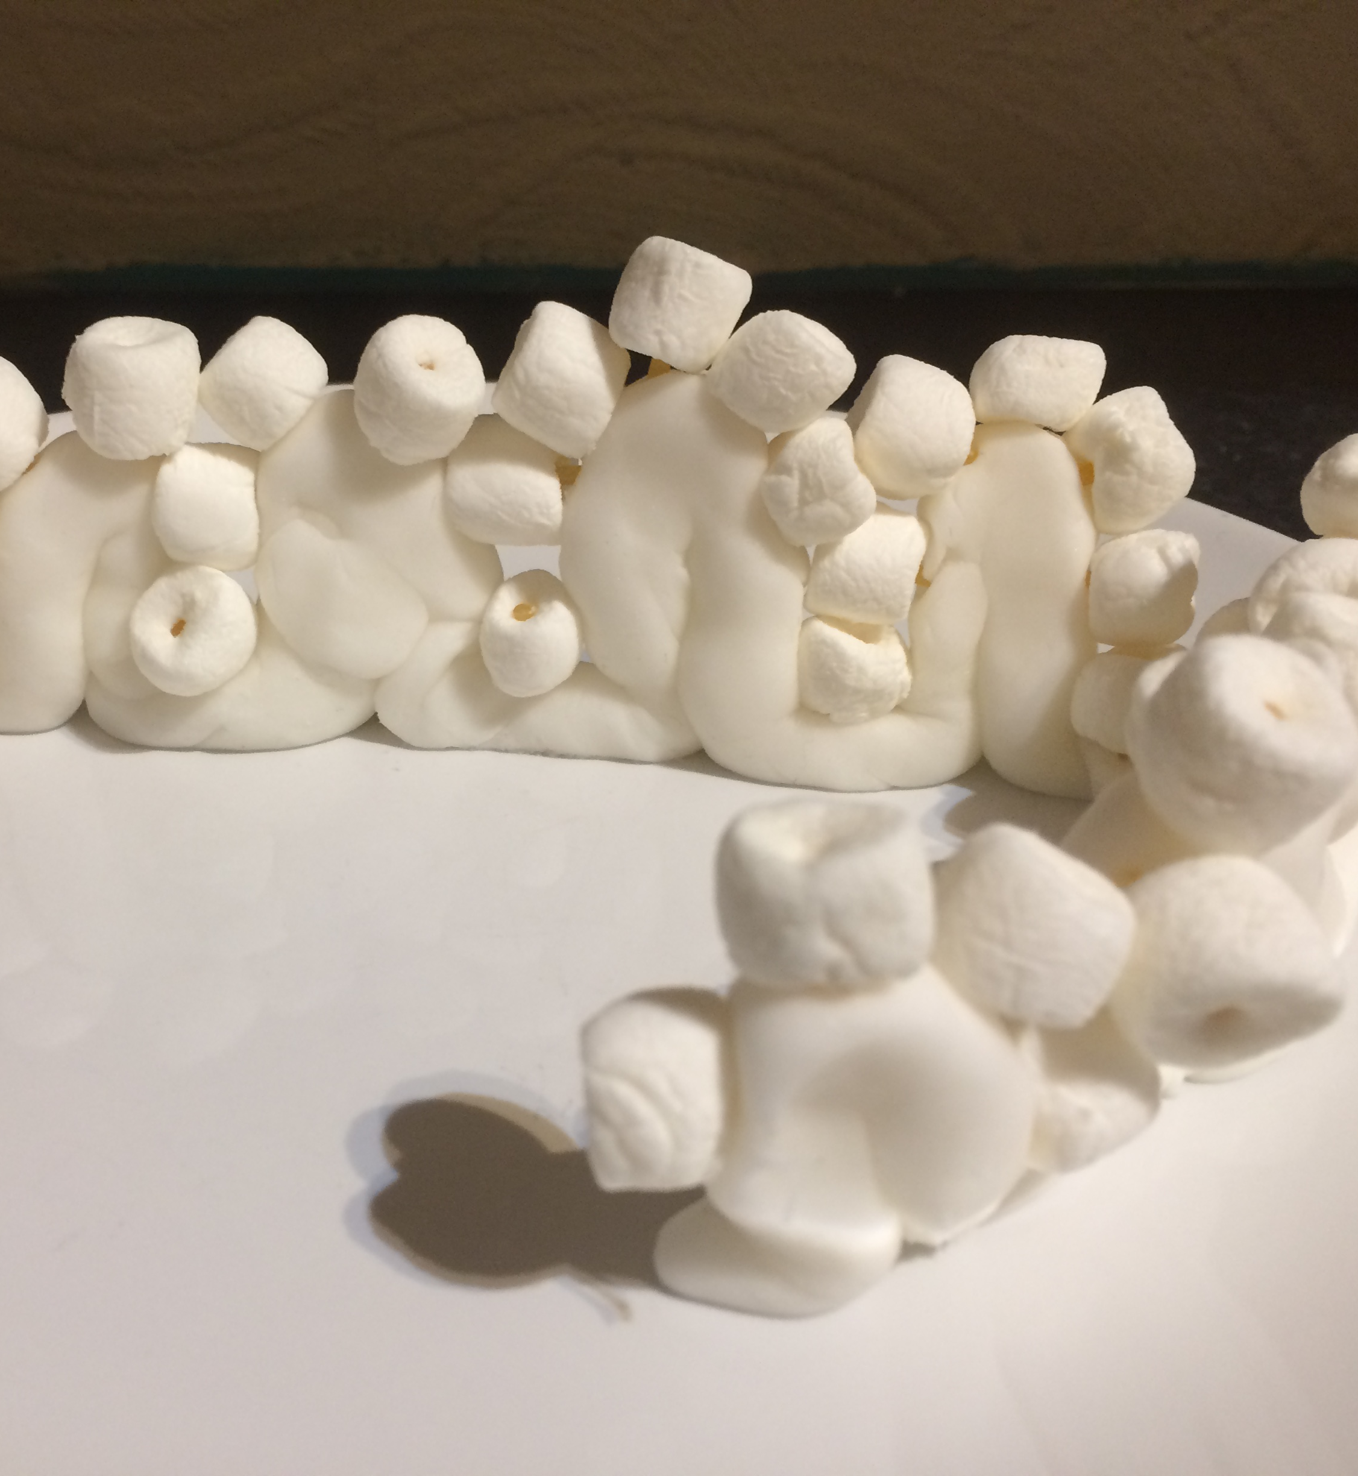
Build your own intestine to replace the intestine that is lost
The villi wall – ICING
The stem cells at the base of each villi – 5 pink marshmallows
The other intestine cells – 15 white marshmallows

